Slide 1
Ecommerce website for electronic devices

Slide 2

Ecommerce website for electronic devices

Slide 3
Project members
Yahia Mohamed Abdelbaset 2001493
Mahmoud Ebrahim Ali Hefny 2000025
Ahmed Mohamed El Amin 2000845
Omar Mohamed Fathy 2001301
Omar Mohamed Mokhtar 2000278
Ahmed Fathy Mohamed 2000806
Abdullah Gaber Farghaly 2000867

Slide 4
WHAT WE ARE WORKING ON
SECURE
ACCESSIBLE
FAST AND RELIABLE

Slide 5
TABLE OF CONTENTS
01
04
introduction
Methodologies
02
05
statistics
Tools and Language
03
06
Project goals
Project Actors
Brief intro about the project
What methodology are we going to use through out the development
Some statistics that prove how important e commerce is
What technology we will use
Our goals
People that will use our project

Slide 6
TABLE OF CONTENTS
Limitation of work
Future work
07
08
Future functionality and solutions
Some limitations

Slide 7
Statistics
In 2022, the United States retail ecommerce ecosystem generated approximately $856.8 billion in revenue.
In 2023, an estimated 2.64 billion consumers will have completed at least one purchase online.
The global ecommerce market growth rate peaked at 17.1% in 2021, and it’s projected to maintain a growth rate of at least 8% over the next several years.
Total global ecommerce sales are projected to grow by 50% over the next three years.

Slide 8
Statistics
study conducted by researches at the GVU (Graphics, Visualization, and Usability) Center at the Georgia Institute of Technology , the researchers report that “e-commerce is taking off both in terms of the number of users shopping as well as the total amount people are spending via Internet based transactions”
Over three quarters of the 10,000 respondents report having purchased items online.
The most cited reason for using the web for personal shopping was convenience (65%),
followed by availability of vendor information (60%),
no pressure form sales person (55%)
and saving time (53%).

Slide 9
introduction
The business-to-consumer aspect of electronic commerce (e-commerce) is the most visible business use of the World Wide Web. The primary goal of an e-commerce site is to sell goods and services online.
This project deals with developing an e-commerce website for electronics devices .
It provides the user with a catalog of different devices available for purchase in the store.
In order to facilitate online purchase a shopping cart is provided to the user.
The system is implemented using a 3-tier approach, with a backend database, a middle tier of Django, and a web browser as the front end client
At checkout time, the items in the shopping cart will be presented as an order. At that time, more information will be needed to complete the transaction. Usually, the customer will be asked to fill or select a billing address, a shipping address, a shipping option, and payment information such as bKash, or Cash on Delivery. An e-mail notification is sent to the customer as soon as the order is placed.

Slide 10
Introduction to similar applications
Amazon(AWS) , Insta shop , Alibaba ,Walmart
The leading platform is of course Amazon (www.amazon.com)
Amazon is available in all regions
Advantages : Wide Product Selection , Competitive Pricing, Customer Reviews, Third-Party Sellers
Disadvantages: Counterfeit Products, Seller Reputation and Trust, Overwhelming Product Selection

Slide 11
Project goals
The objective of this application is to provide the user an online website where they can buy electronic devices from the comfort of their home.
A shopping cart is used for the purpose.
The user can select the desired product, place them in the shopping cart and purchase them using a Credit Card.
The user’s order will be shipped according to the type of shipping selected at the time of placing the order.

Slide 12
Project goals
Effective categorical organization of products
Consistent layout of product information.
feedback on the products specifically and the website in general
Completed orders should be acknowledged quickly
Purchase history

Slide 13
Agile methodology
Steps
Goals : The first step in any web design project is to set clear goals
Requirements Gathering : collaborate with stakeholders to gather requirements, user stories, and define the product backlog. Prioritize the backlog items based on value and feasibility.
Sprint Planning: Select a set of prioritized backlog items to be worked on in the upcoming sprint. Break down the selected items into smaller tasks, estimate effort, and define the sprint goal.

Slide 14
Agile methodology
Steps
Iterate: After each sprint, the team takes a step back and subjects the outcome of the sprint to user-
centric testing, analysis, and feedback. Data collected from feedback and functionality metrics are
reincorporated back into the process
Production : Once all the project goals have been met, the design is usually production-ready and can
move to the development phase. While this might seem like the end of the process, the concept of agile
assumes that this step can loop back to any previous stages

Slide 15
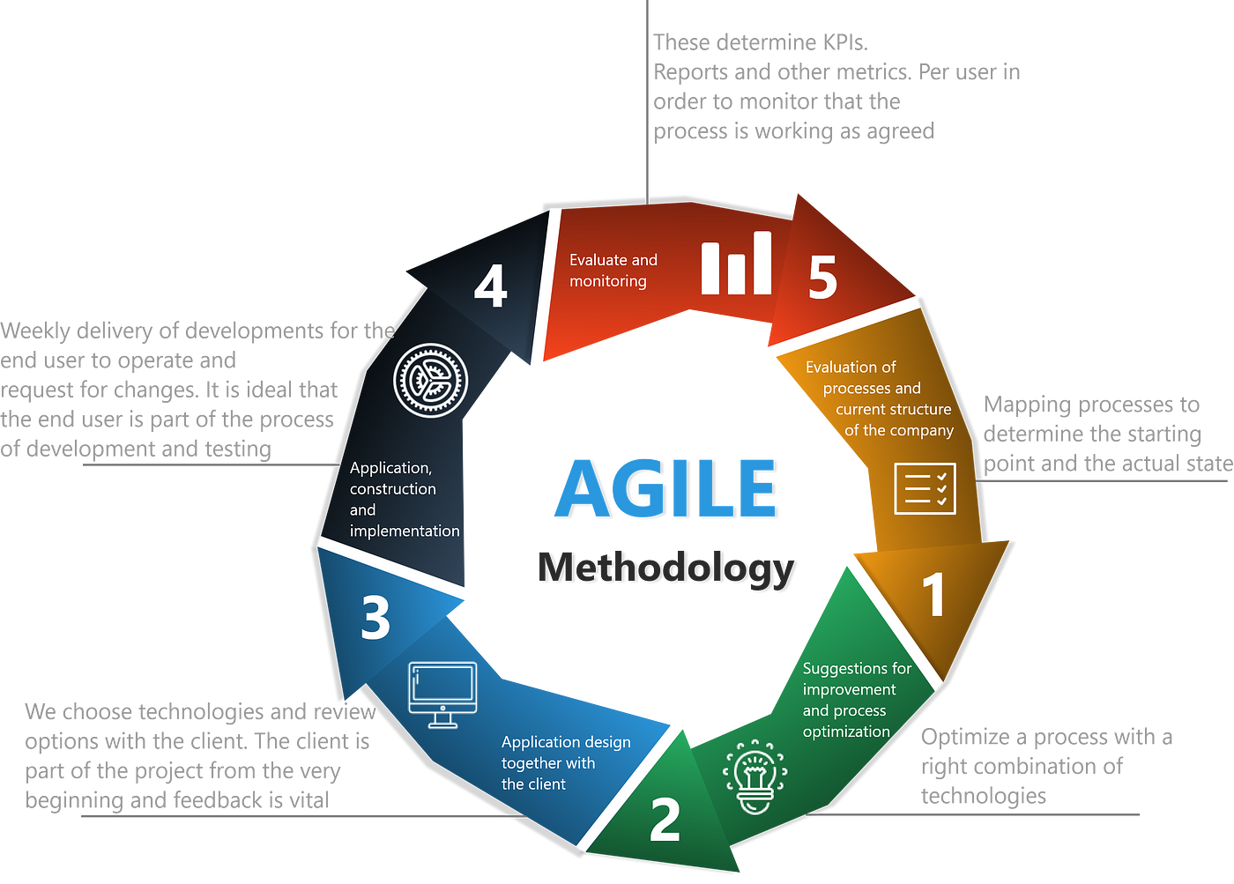
Agile methodology
Why Agile ?
Adaptability : Agile methodologies emphasize flexibility and adaptability to change
Faster Delivery : Agile promotes iterative development cycles, enabling faster delivery of working software or products in smaller increments

Slide 16
Agile methodology
Why Agile ?
Customer-Centric Approach : Agile methodologies focus on close collaboration with customers and stakeholders , It ensures that the delivered product meets their needs
Transparency and Visibility : Agile practices promote transparency and regular communication within the team and with stakeholders.
Risk Mitigation : Agile’s iterative approach allows for early identification and mitigation of risks, as well as the ability to make necessary adjustments throughout the project .

Slide 17

Tools and Language Design
Figma
Collaborative Design: Figma is built for collaboration, allowing multiple designers to work simultaneously on the same project
Cloud-Based Platform: Figma operates in the cloud, which means there is no need to install or maintain software locally
Cross-Platform Compatibility: Figma is web-based and works on both macOS and Windows platforms

Slide 18

Tools and Language Front-End
React
Component-Based Architecture: React follows a component-based architecture, allowing developers to break down the user interface into reusable and modular components
Declarative Syntax: React uses a declarative syntax, allowing developers to describe how the UI should look based on the application state. Instead of directly manipulating the DOM, developers define the desired UI state, and React takes care of updating the DOM accordingly.
React Native: React can be used to develop not only web applications but also mobile applications using React Native
Testing and Debugging: React provides robust tools and libraries for testing and debugging.

Slide 19

Tools and Language back-end
Django
Django is a high-level Python web framework that simplifies and expedites web development by providing a robust set of tools and features
High Productivity: Django follows the principle of "Don't Repeat Yourself" (DRY) and provides a comprehensive set of built-in functionalities
Scalability: Django is designed to handle high-traffic websites and can scale efficiently. It supports various deployment options
Security: Django takes security seriously and provides built-in protection against common web vulnerabilities
Versatile ORM: Django comes with a powerful Object-Relational Mapping (ORM) layer that abstracts database interactions. This allows developers to work with databases using Python objects and methods

Slide 20

Tools and Language back-end
postgreSQL
powerful open-source relational database management system (RDBMS) known for its robustness, scalability, and extensive feature set
Reliability and Stability: PostgreSQL is known for its reliability and stability, making it suitable for mission-critical applications
Advanced Features: PostgreSQL offers a wide range of advanced features not found in many other databases. It supports complex queries, indexing techniques, and advanced data types such as arrays, JSON, and spatial data
Scalability: PostgreSQL is designed to handle large and demanding workloads. It supports horizontal scaling through its built-in replication capabilities,
Concurrency Control: PostgreSQL's MVCC system allows for excellent concurrency control, enabling multiple transactions to occur simultaneously without blocking each other

Slide 21

Project actors
Customer
They can log in /register
Browse/search for products
Add products to shopping cart
Make purchase
review / rate

Slide 22
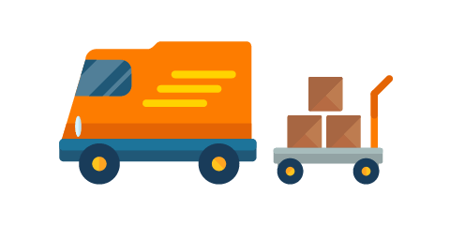
Project actors
Suppliers / sellers
They can log in /register
Add /delete /update product to/from their inventory
Browse / search for products
Update price / sales

Slide 23

Project actors
Administrator
They can log in /register
delete /update products
Browse / search for products
Ban users
Reorder products

Slide 24
Limitation of work
There are some limitations for the current to which solutions can be provided as a future systemdevelopment:
Credit Card validation is not done.
Customer cannot make multiple shopping cart at the same time
Smart / customized recommendation system for customers
More privileges to administrators like looking at customer profile and reorder products etc.

Slide 25
Future work
for other future developments, the following can be done :
As for credit card validation Third party proprietary software can be used for validation check.
The Administrator of the web site can be given more functionalities, like looking at a specific customer’s profile, the products that have to be reordered, etc.
Multiple Shopping carts can be allowed.
Integration of ai model and using third party cookies to give the customer customized and smart recommendations

Slide 26
THANKS!

